Slide 1
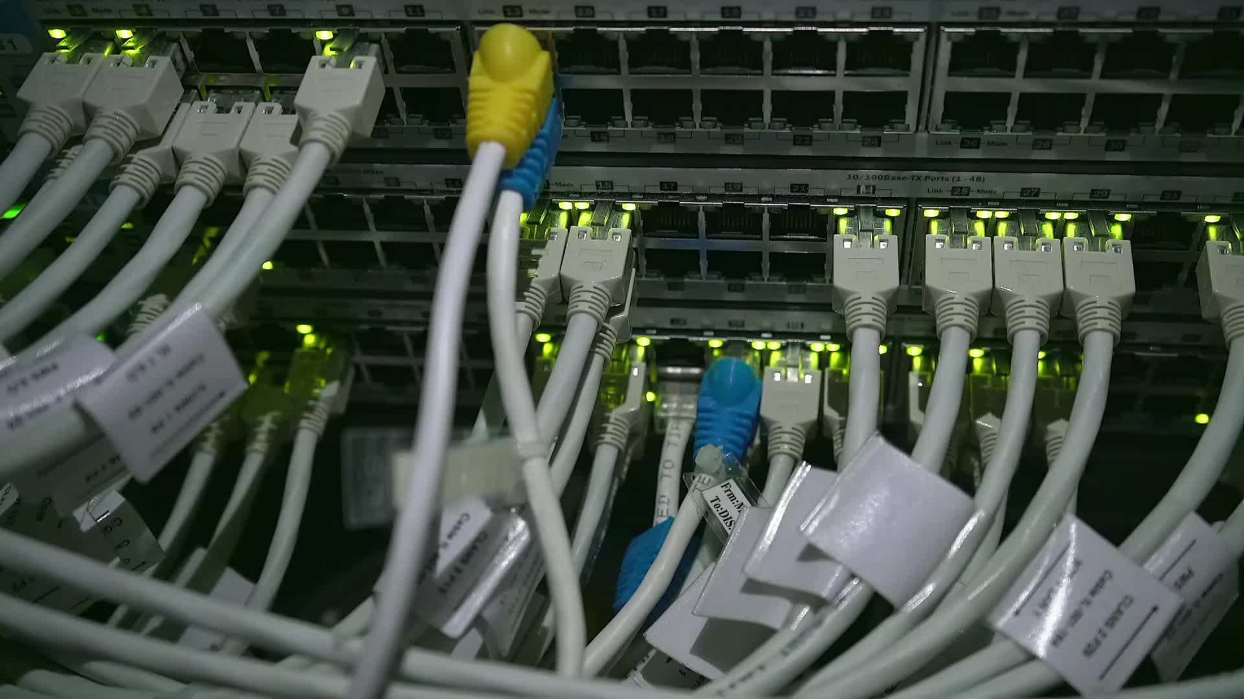
IoT Hub
Connecting the Digital World
BY
Abdullah Hussaini
Abdul Qudoos
Mustafa

Slide 2
Introduction to IoT
network of interconnected physical devices
i.e. vehicles, appliances, and other objects embedded with sensors, software, and connectivity
enable them to collect and exchange data.

Slide 3
What is an IoT Hub
Serves as central component of IoT solution
providing necessary infrastructure to connect and control IoT devices
Acts as gateway for data exchange
facilitates communication between devices and cloud-based applications.

Slide 4

IoT Types
1. Cloud-Based IoT Hubs: These hubs are hosted on cloud platforms and provide scalable infrastructure for managing and processing IoT data.
2. On-Premises IoT Hubs: These hubs are deployed locally within an organization's premises, offering greater control over data privacy and security.
3. Hybrid IoT Hubs: Hybrid hubs combine cloud-based and on-premises capabilities, allowing for flexible deployment models.

Slide 5
IoT Hub Components
1. Device Connectivity: IoT hubs support various protocols and communication channels to connect IoT devices securely.
2. Device Registry: This component manages device metadata, such as device ID, authentication keys, and status.
3. Message Routing: IoT hubs facilitate the routing of messages between devices and cloud services based on predefined rules.
4. Telemetry Processing: Hubs process and analyze telemetry data from devices, enabling real-time insights and decision-making.
5. Security and Authentication: IoT hubs provide robust security mechanisms to authenticate and authorize devices and protect data.

Slide 6
IoT Hub Architecture

Slide 7
IoT Hub Deployment Considerations
1. Scalability: IoT hubs should be able to handle a large number of devices and accommodate future growth.
2. Security: Robust security measures, such as encryption and access controls, are crucial to protect IoT devices and data.
3. Connectivity: Hubs should support various connectivity options like Wi-Fi, cellular, and wired connections to cater to diverse device requirements.
4. Integration: Consider the ability of the IoT hub to integrate with existing systems, databases, and third-party services.
5. Data Management: Efficient data storage, processing, and analytics capabilities are essential for deriving valuable insights from IoT data.

Slide 8
IoT Hub Use Cases
1. Smart Home Automation
2. Industrial Automation and Predictive Maintenance
3. Healthcare Monitoring and Telemedicine
4. Smart Agriculture and Precision Farming
5. Smart Cities and Infrastructure Management

Slide 9
IoT Hub Benefits
1. Improved Efficiency: IoT hubs streamline device management, data collection, and analysis, leading to enhanced operational efficiency.
2. Real-time Insights: By processing and analyzing data in real-time, IoT hubs enable timely decision-making and actionable insights.
3. Cost Savings: Automation and predictive maintenance facilitated by IoT hubs can reduce operational costs and optimize resource utilization.

Slide 10
IoT Hub Challenges
1. Interoperability: Ensuring seamless interoperability between diverse devices, protocols, and platforms can be a challenge.
2. Data Privacy and Security: Protecting sensitive data and maintaining privacy while transmitting and storing data is a significant concern.
3. Scalability and Performance: Handling a massive number of devices and processing a vast amount of data with low latency can be challenging.
4. Standardization: Lack of industry-wide standards for IoT devices and protocols can hinder seamless integration and compatibility.

Slide 11

IoT Hub Connectivity
Various connectivity options supported by IoT hubs
Wi-Fi
Bluetooth
Cellular
Zigbee
Importance of reliable and secure connections for seamless device communication.

Slide 12
Device Registry and Management
Device registry component of IoT hubs
stores device metadata and manages device lifecycle operations
How the device registry enables efficient device provisioning, authentication, and management.

Slide 13
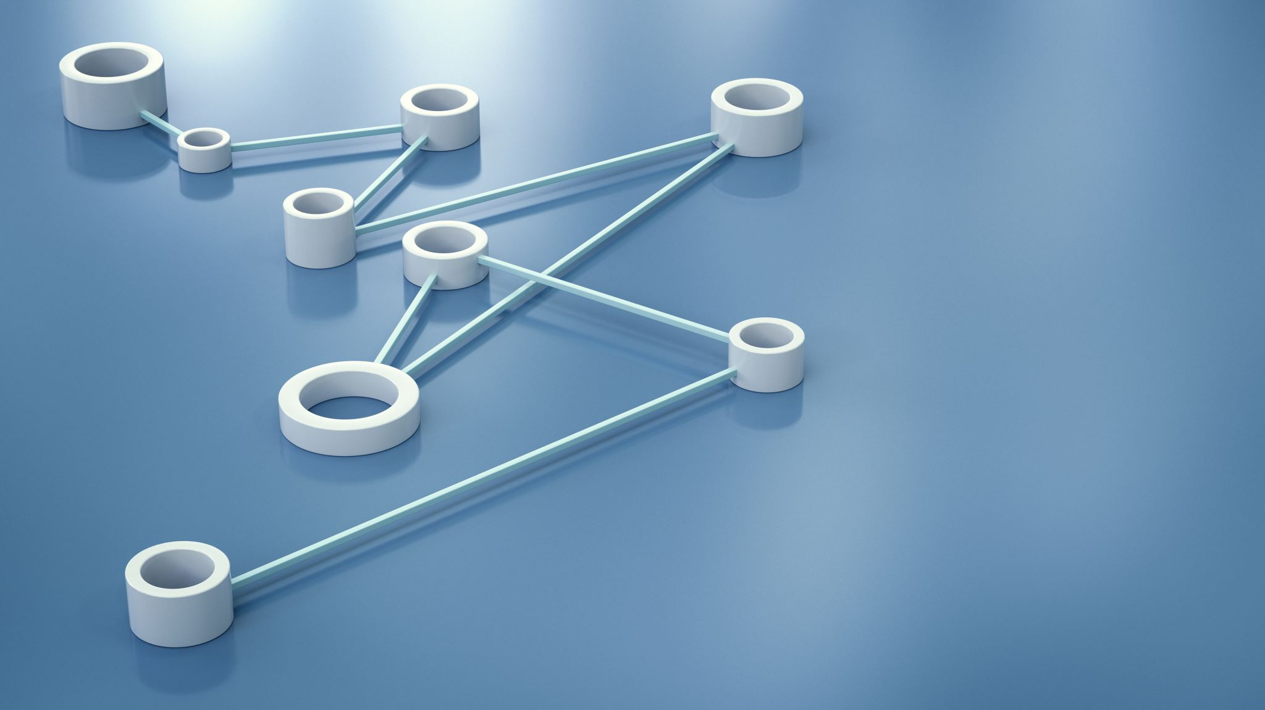
Message Routing and Data Processing
how IoT hubs facilitate the routing of messages between devices and cloud services based on predefined rules. Explain how data processing capabilities within IoT hubs enable real-time analysis, aggregation, and transformation of data.

Slide 14

Security and Authentication
Highlight the critical role of security in IoT hubs. Discuss authentication mechanisms, encryption, and access controls implemented within IoT hubs to ensure the integrity, confidentiality, and authenticity of data and devices.

Slide 15

Scalability and Performance
Emphasize the need for IoT hubs to handle large-scale deployments and accommodate increasing numbers of connected devices. Discuss how IoT hubs scale horizontally and vertically to maintain optimal performance and handle growing data volumes.

Slide 16
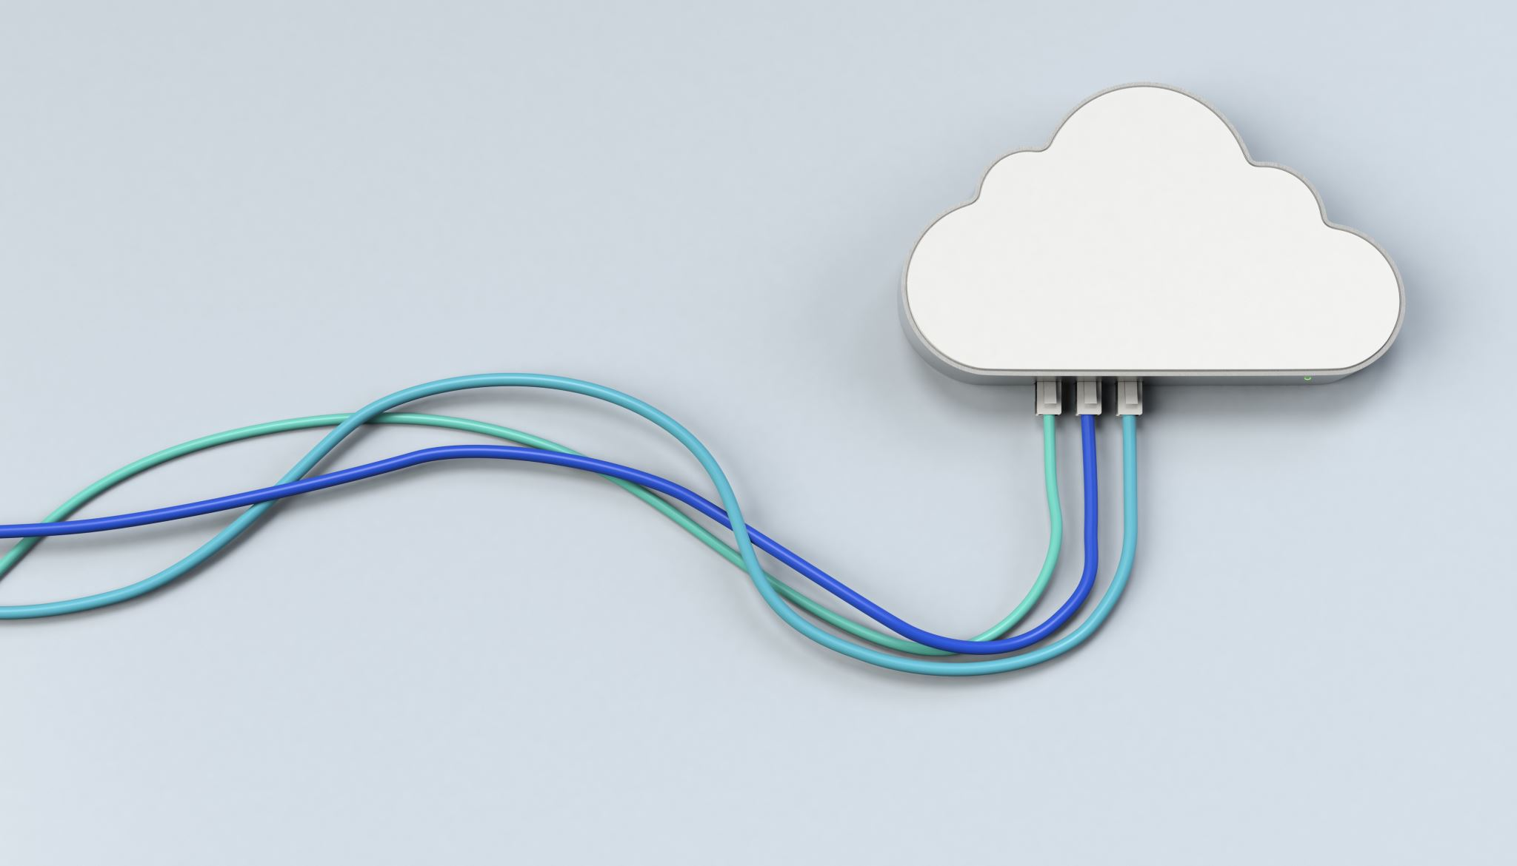
Integration with Cloud Services
Explain how IoT hubs integrate with cloud-based services, such as data storage, analytics, and machine learning platforms. Highlight the benefits of leveraging cloud capabilities for data processing, advanced analytics, and deriving valuable insights.

Slide 17
Data Analytics and Visualization
Discuss the role of IoT hubs in collecting and processing data for advanced analytics. Highlight how IoT hubs enable the visualization of data through dashboards and reports, empowering users to gain actionable insights from IoT-generated data.

Slide 18
IoT Hub Deployment Models
Discuss different deployment models for IoT hubs
public cloud
private cloud
hybrid deployments.
Explain the considerations for selecting an appropriate deployment model based on security, scalability, and organizational requirements.

Slide 19

Thank You

